Slide 1
Ind Study W3

Slide 2
Content
CNN architecture
Alexnet
VGG
ResNet
GoogLeNet
Transfer Learning
Data Augmentation
Multi-crop

Slide 3
Alexnet
Data Augmentation
Horizontal reflection
Altering the intensities of RGB channels in training images (Perform PCA)
Dropout
Helps in coadoption of neurons in absence of some other neuron
Contains local response normalization

Slide 4
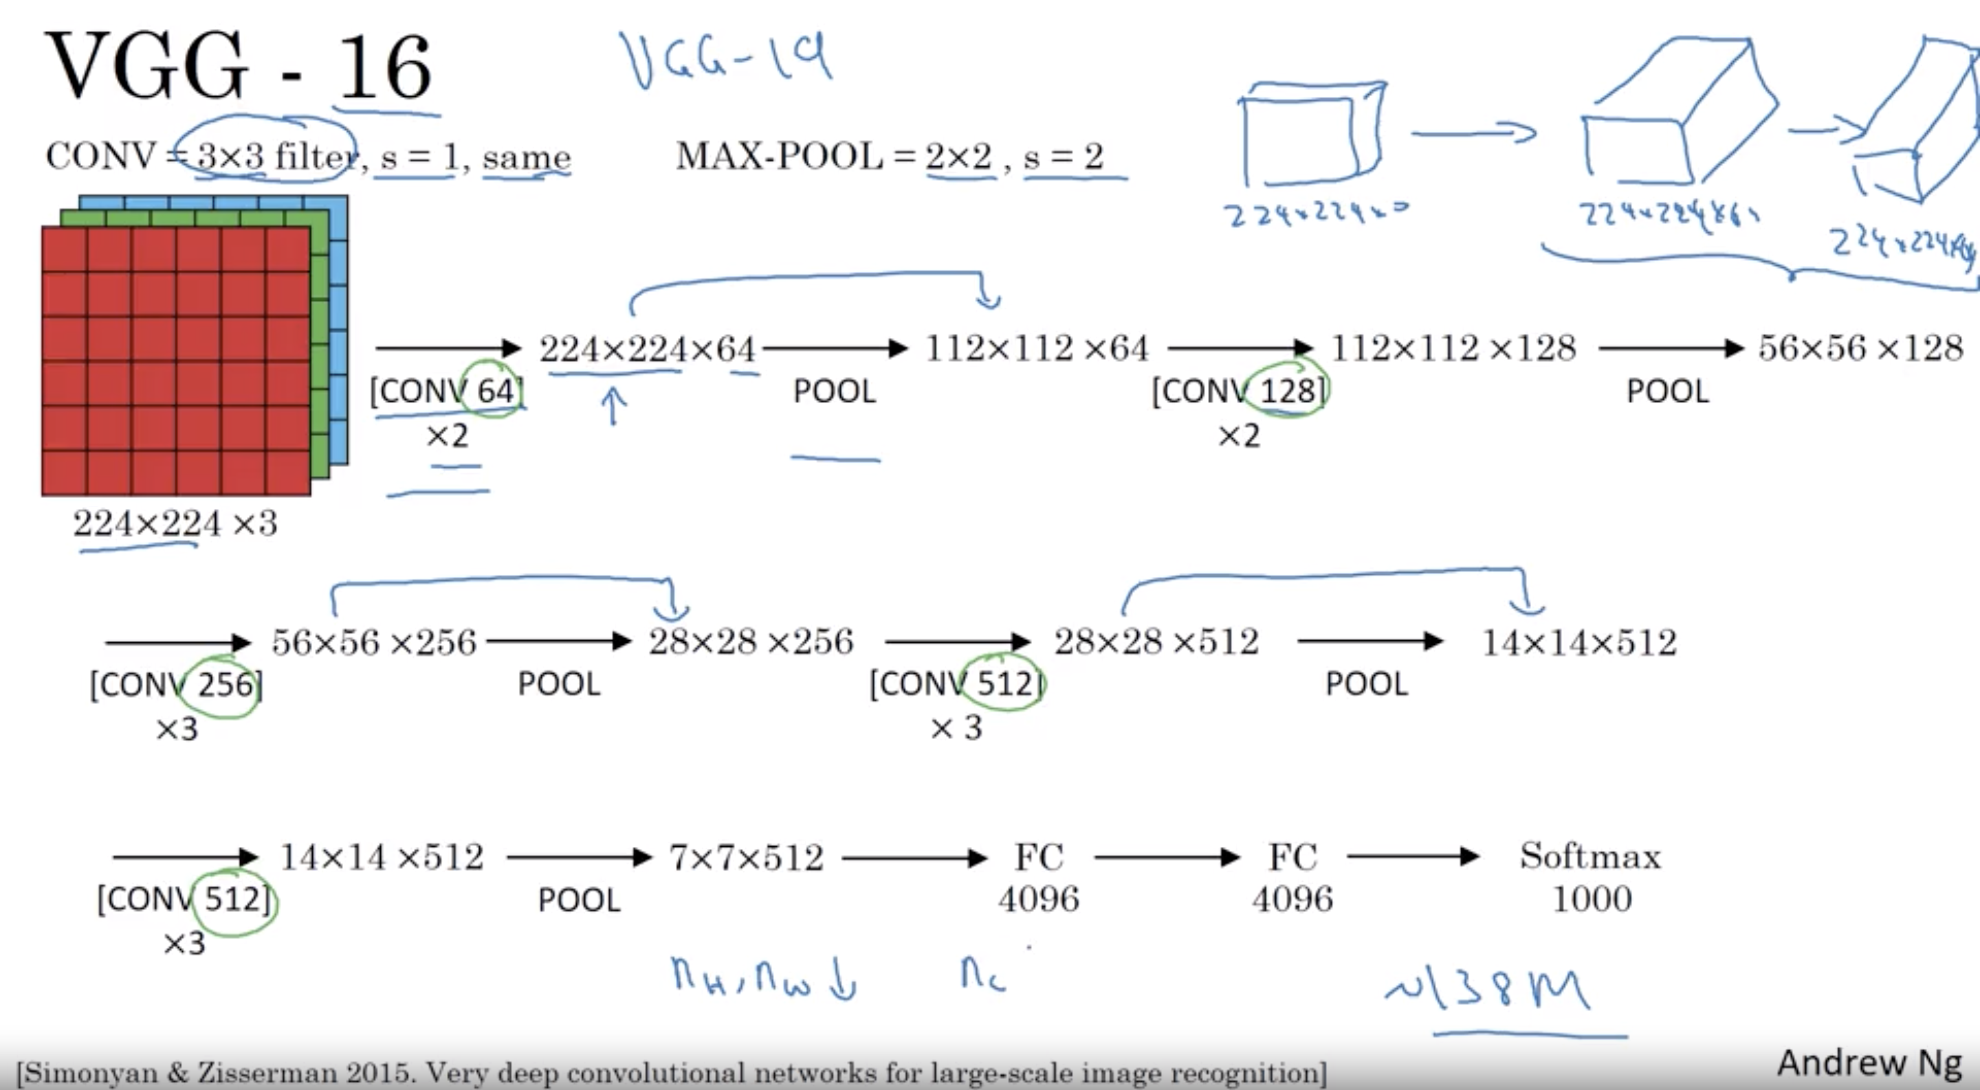

Slide 5
VGG
Address depth of CNN( Fix all other parameters and increase depth)
Preprocessing- Subtracting the mean RGB value
Architechture
Filters-3*3 and 1*1, stride-1
Same Padding -1 for 3*3 filter
Followed by spatial + max pooling (f=2,s=2) for some layers
Followed by 3 fully connected layers (same configuration in all network)
First two FC 4096 channels each , third 1000 channels
Final layer is softmax
Contains RELU but not local response normalization
Having 3*3 instead of 7*7:
Decreases number of parameters 27C² instead of 49C²
Incorporate 3 non-linear rectification function instead of one, making decision function more discriminative
Imposing regularization

Slide 6
VGG-Training
Multinomial logistic regression with mini-batch gradient descent with momentum
Batch size-256, momentum -0.9
Weight decay and regularization (dropout ratio=0.5)
Learning rate- 10⁻² , 370K iterations (74 epochs)
Required less epochs due to
Implicit regularization imposed by greater depth and smaller conv. Filter sizes
Pre-initialization of certain layers
Setting Training Image Size S: Rescaling training image by randomly sampling S from a certain range [S_{min},S_{max}]

Slide 7
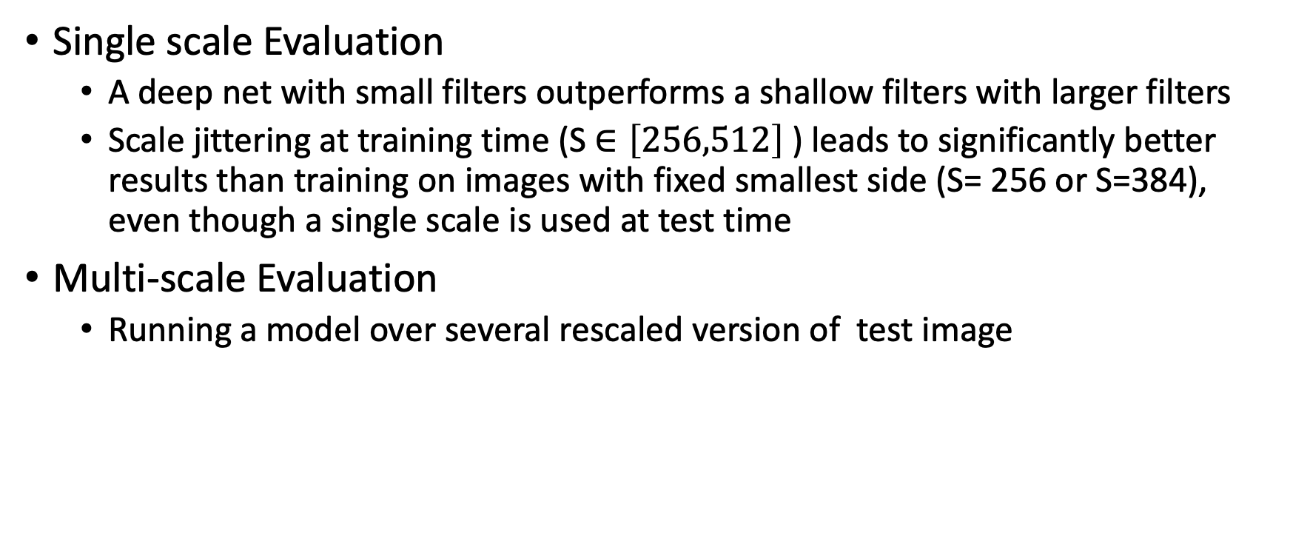
VGG- Experiments
Single scale Evaluation
A deep net with small filters outperforms a shallow filters with larger filters
Scale jittering at training time (S $∈\left[256,512\right]$ ) leads to significantly better results than training on images with fixed smallest side (S= 256 or S=384), even though a single scale is used at test time
Multi-scale Evaluation
Running a model over several rescaled version of test image

Slide 8
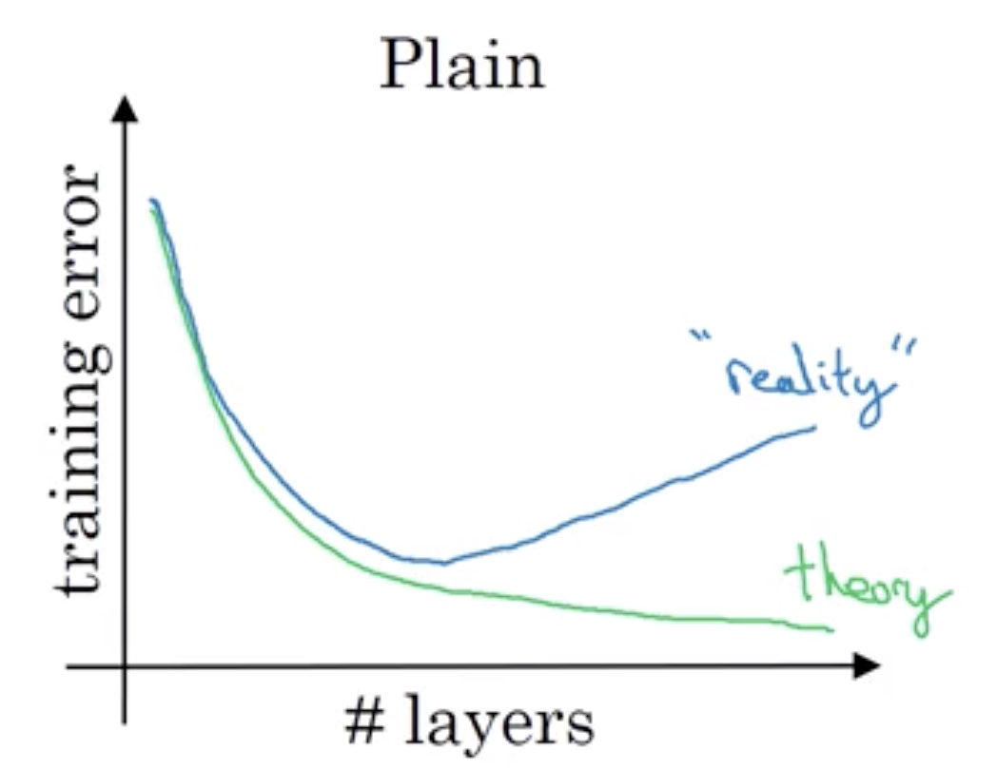
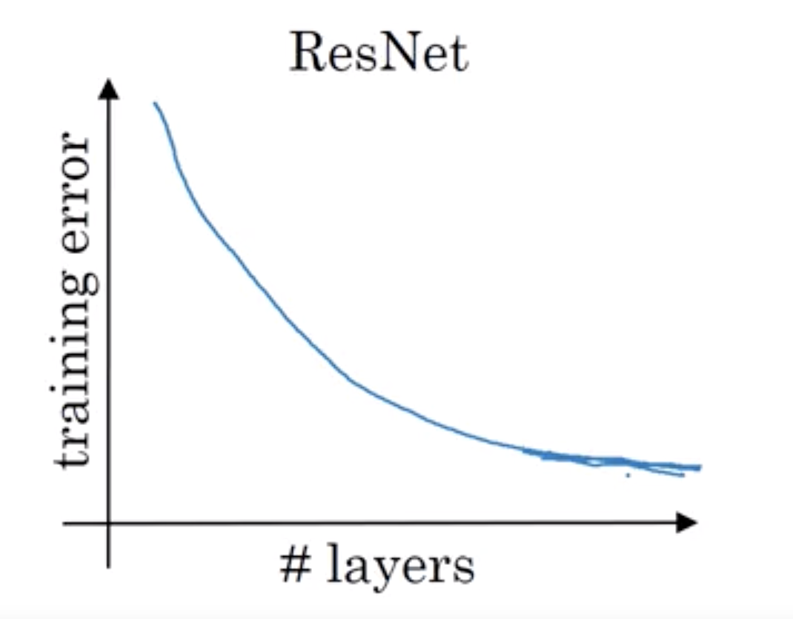
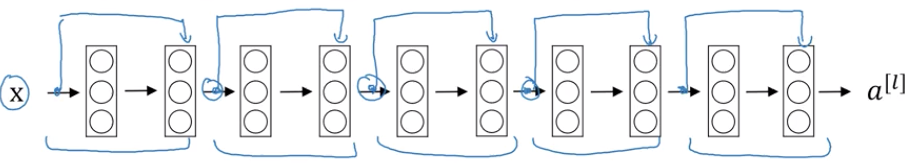
ResNet
Skipping layers to pass over information
a^{[l]} -> Linear->Relu->Linear->Relu->a^{[l+2]}
a^{[l+2]} =g(z^{[l+2]} + a^{[l]} ) ; a^{[l]} passed to relu along with z^{[l+2]}
On plain network the training error tends to decrease first with increasing depth but increases further
In ResNet error always decreases with depth

Slide 9
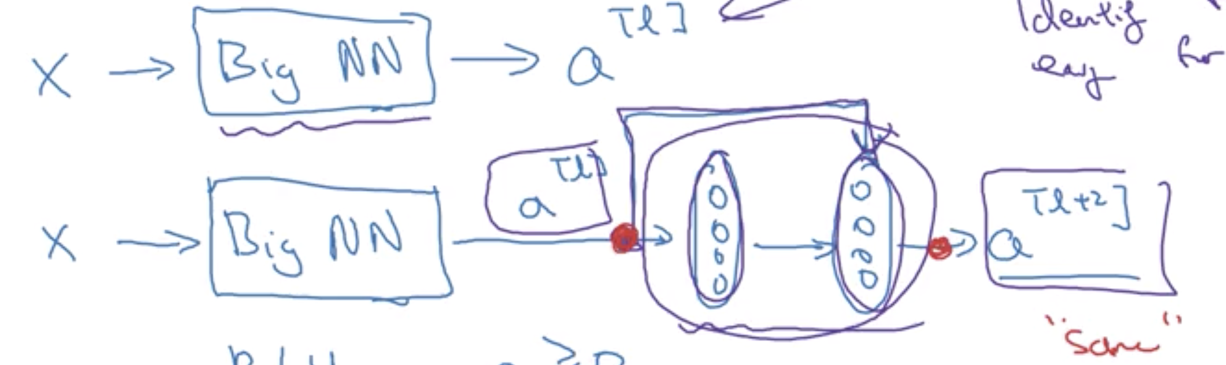
ResNet
a^{[l+2]} =g(z^{[l+2]} + a^{[l]} )= a^{[l+2]} =g(w^{[l+2]} .a^{[l+1]} + b^{[l+2]} + a^{[l]} )
a^{[l+2]} =g(a^{[l]} ); if w^{[l+2]} =0, b^{[l+2]} =0
Use same convolution to have dimension of z^{[l+2]} and a^{[l]} same

Slide 10
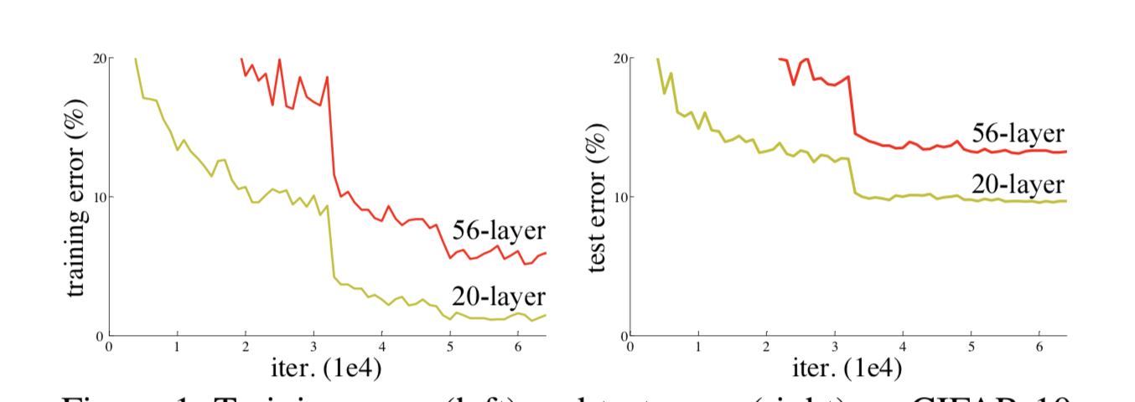
ResNet
Degradation with deeper network does not happen by overfitting
Adding more layers to a deep model leads to higher training error
Shortcut connections act as identity mappings
ResNet converges faster than plain for 18 layers

Slide 11
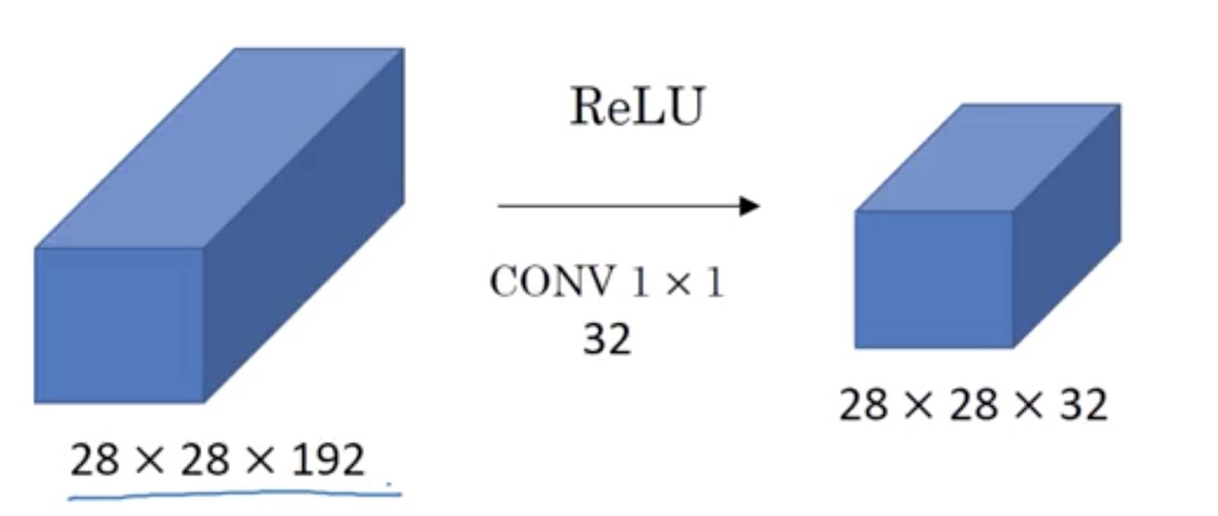
Network in Network (1*1 convolution)
Multiply individual element with a number
Helpful in shrinking number of channels and save computations

Slide 12
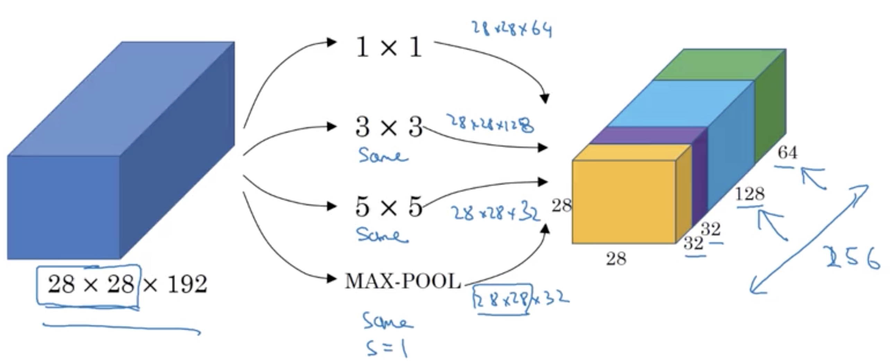
GoogleNet( Inception)
Try all type of convolutions 1*1, 3*3, 5*5 and MAX-POOL
Concatenate all the output and let network learn whatever parameters it want to use

Slide 13
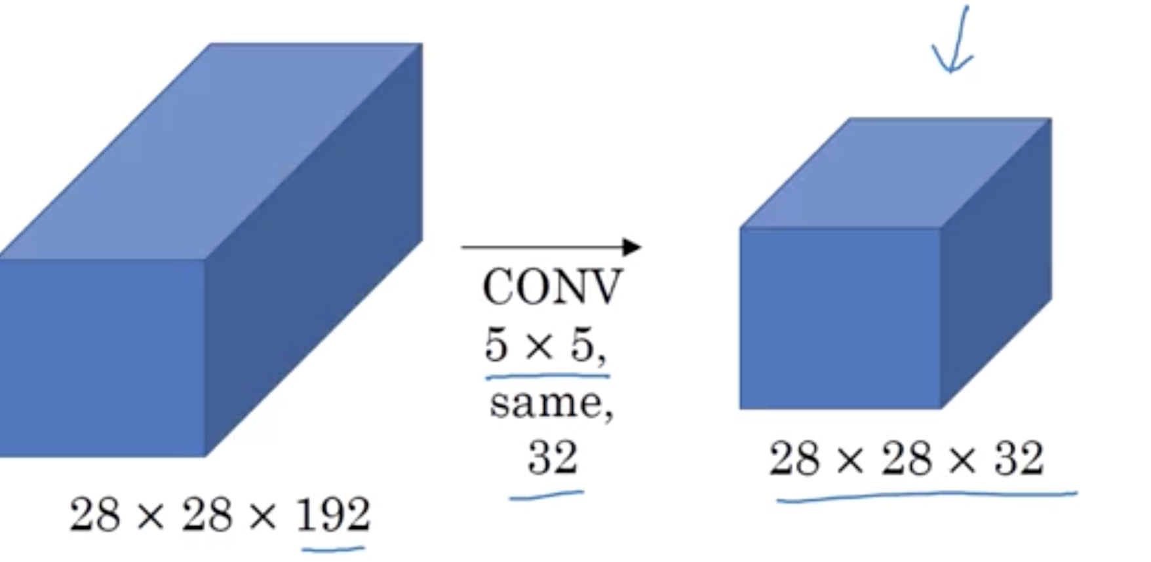
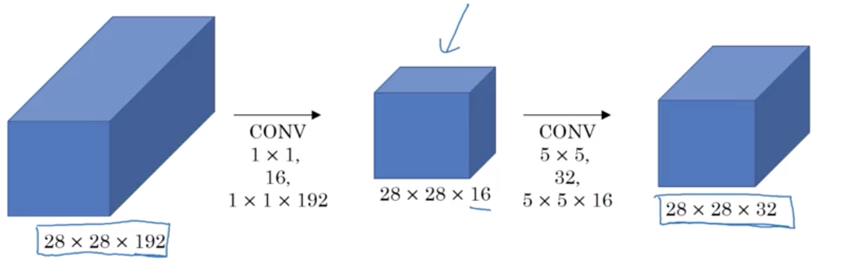
Inception
Computation cost for 5*5 CONV:
32 filters of 5*5*192
28*28*32* 5*5*192= 120M (expensive)
Using 1*1 convolution reduces cost by 1/10th
Introduce a bottleneck layer (28*28*16) in between
New cost=28*28*16*1*1*192 + 28*28*32*5*5*16= 12.4 M

Slide 14
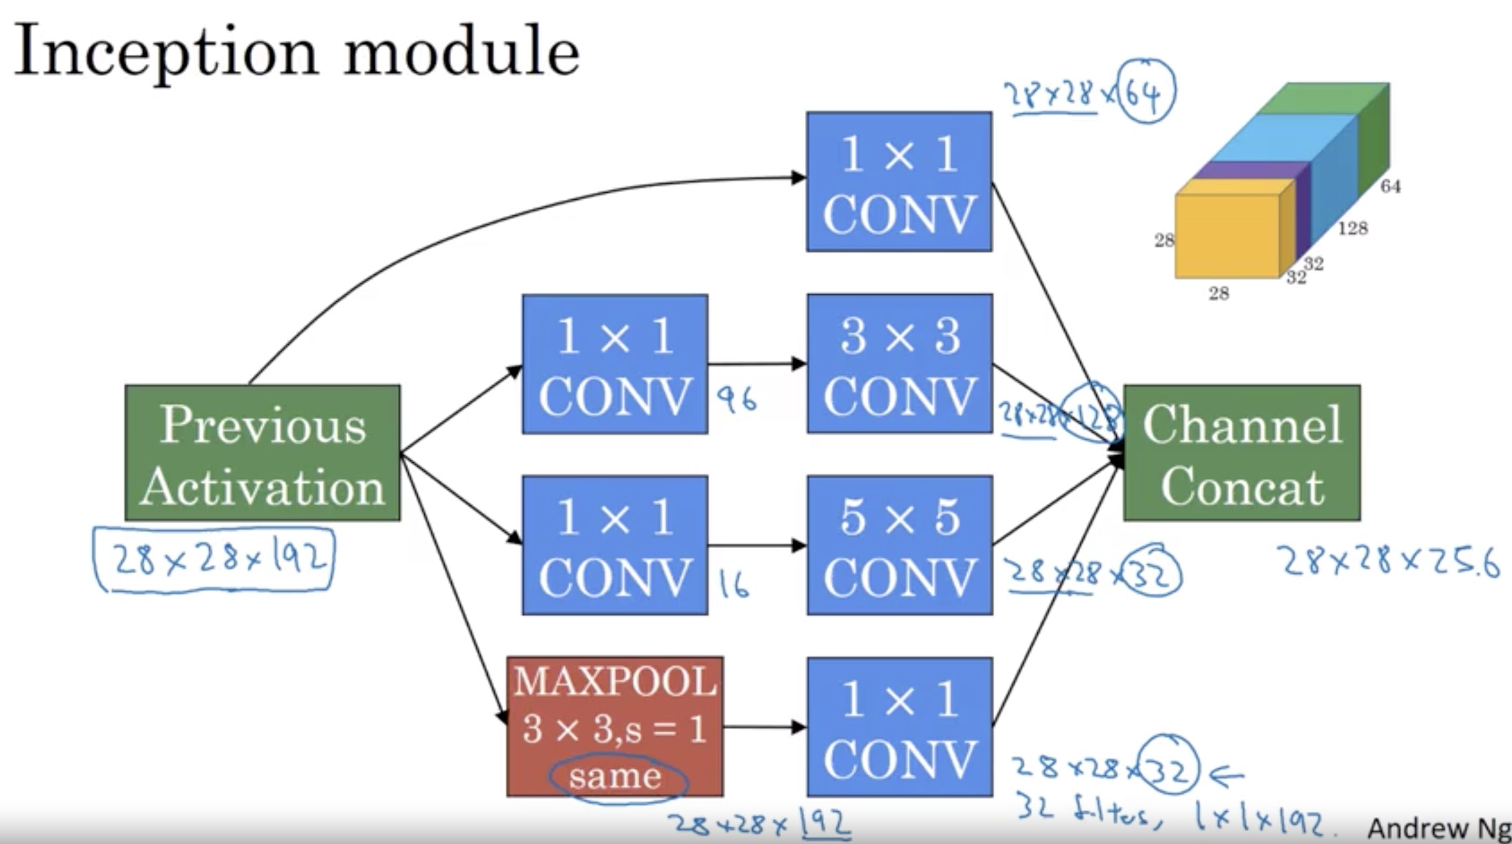

Slide 15
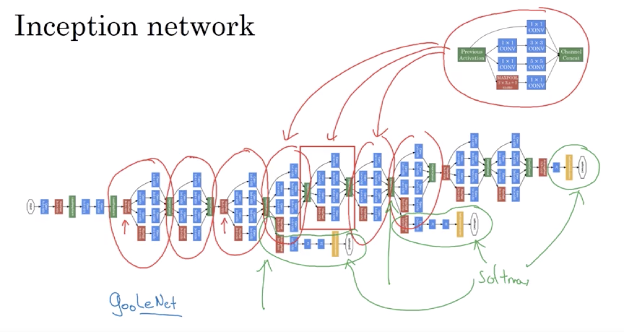

Slide 16
Transfer Learning
Reusing an existing model as starting point for other model
It saves time and computation power which is required to build from scratch.

Slide 17
Data Augmentation
Mirroring
Random Cropping
Rotation
Shearing
Local Warping
Color shifting- take different values of R, G, and B and use them to distort the color channels, bring more robustness with colors
PCA color augmentation- if image is purple it mainly contains red and blue but lesser green, so it adds and subtracts more of RG and less of G

Slide 18
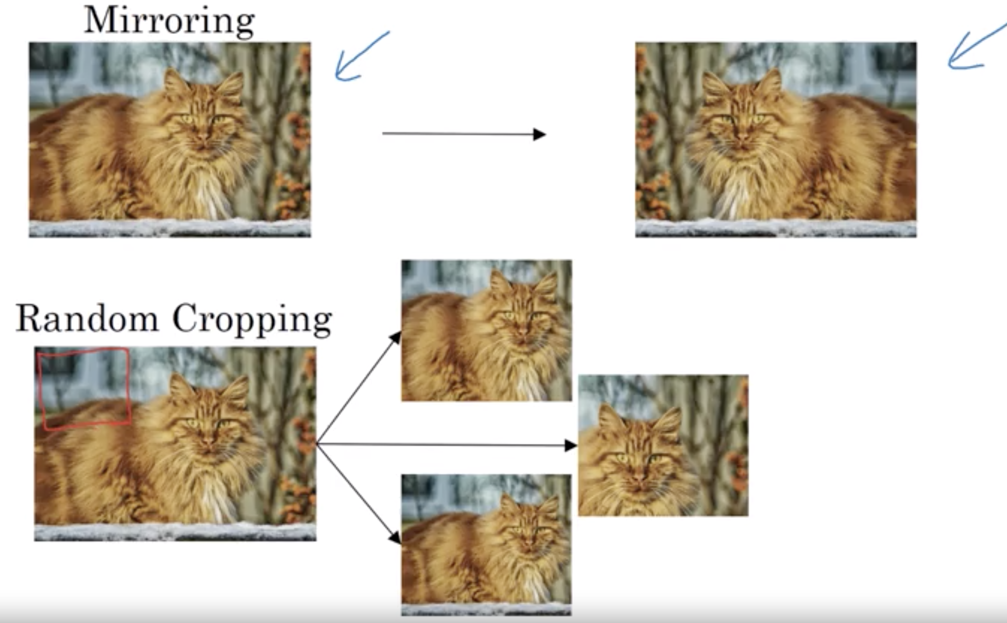
Common Augmentation method

Slide 19
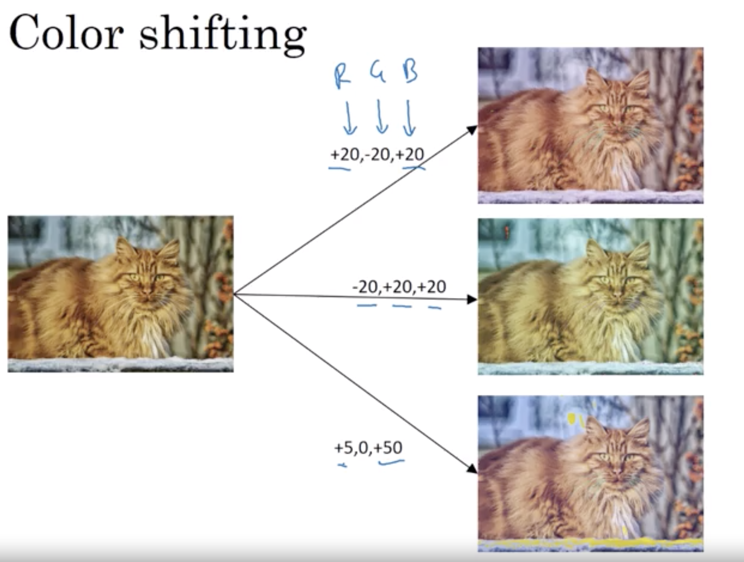
Common Augmentation method

Slide 20
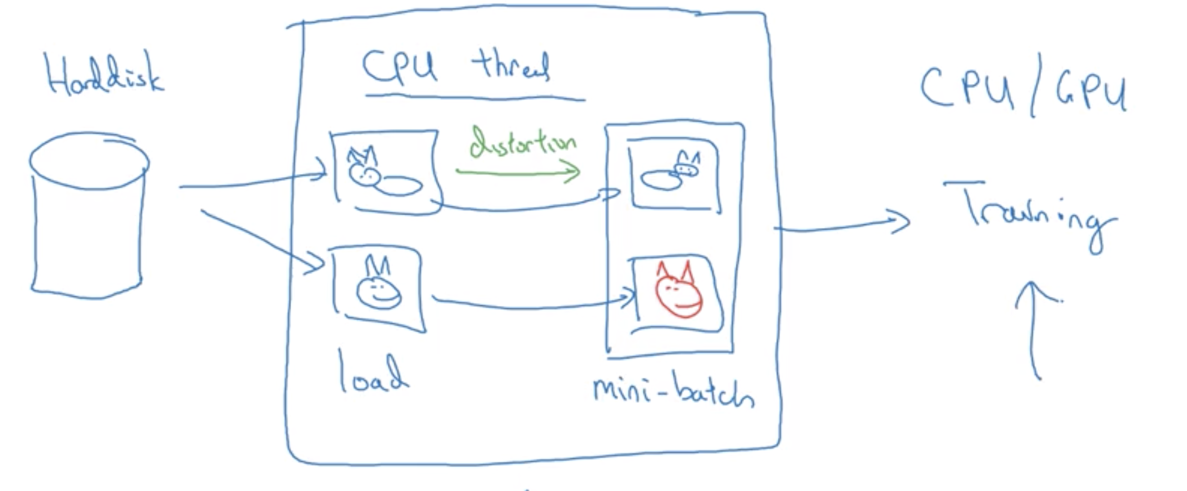
Implementing distortions during training

Slide 21
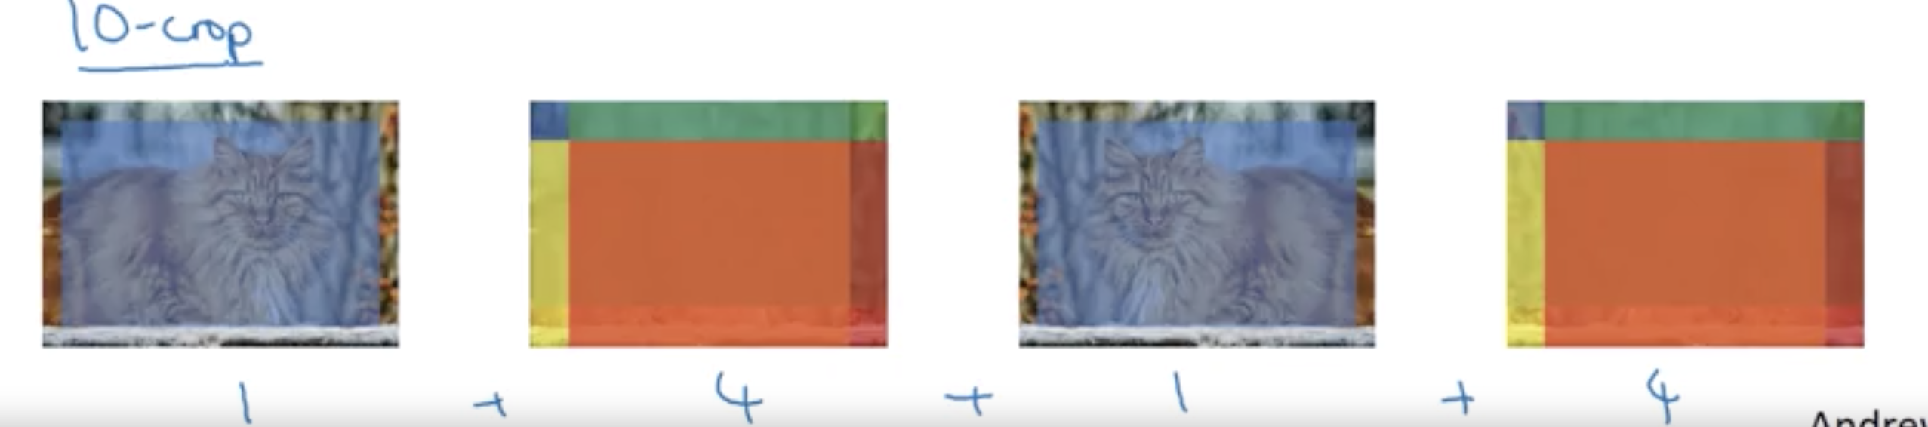
Multi crop at test time
Run classifier on multiple versions of test images and average results
10 crop:

Slide 22
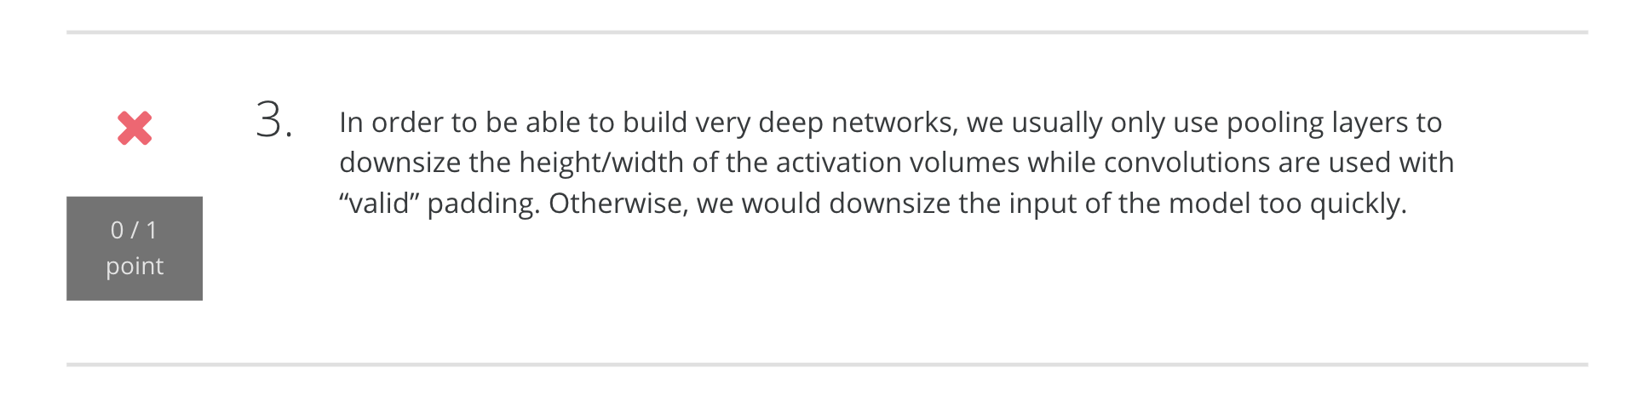
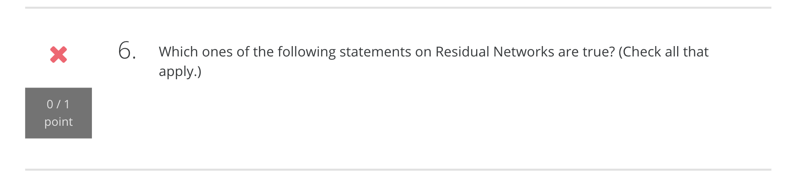
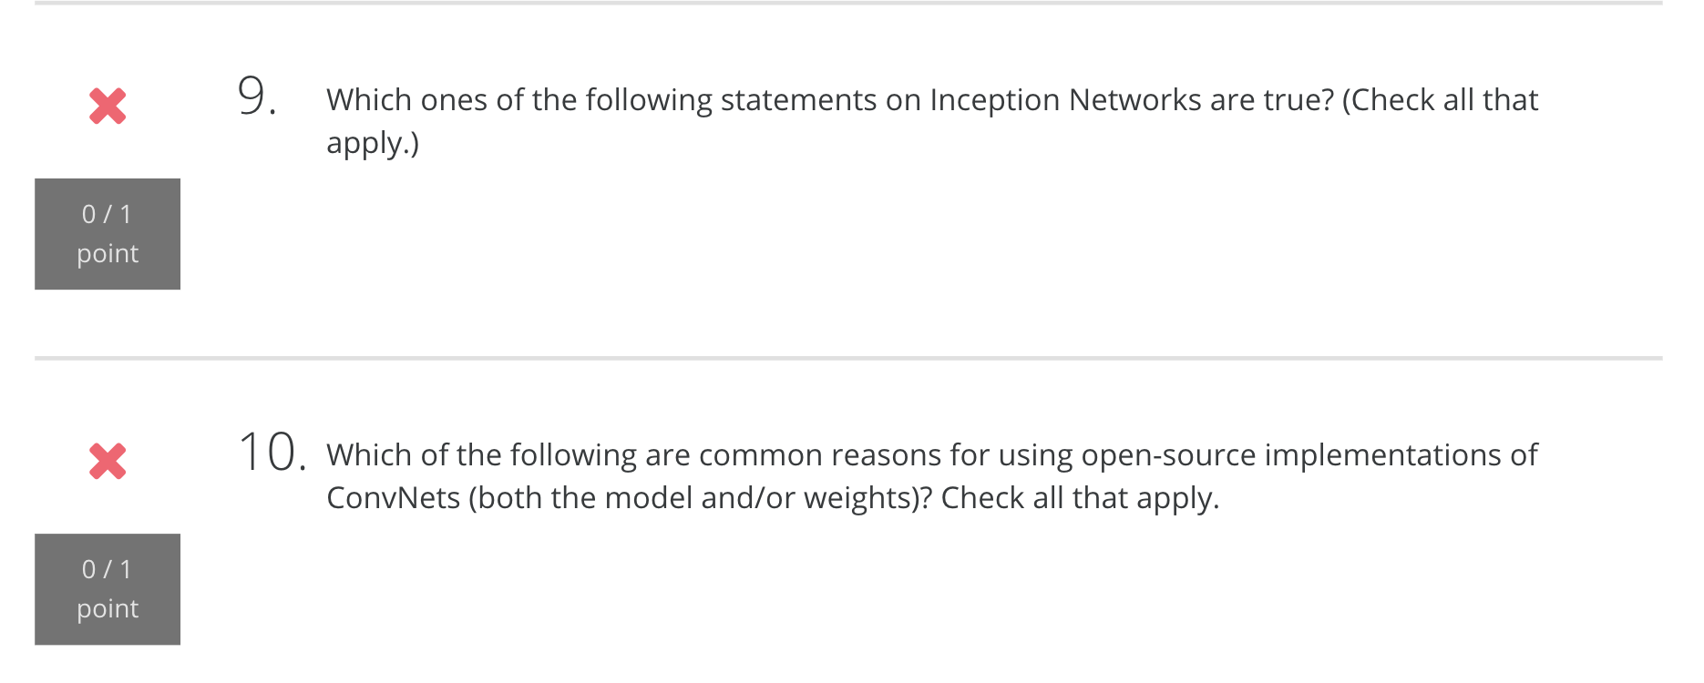
Quiz

Slide 23
References
CUDA implementation of CNN: https://code.google.com/archive/p/cuda-convnet/
Keras documentation: https://keras.io/models/model/
ResNet Blog: http://torch.ch/blog/2016/02/04/resnets.html
ResNet Github: https://github.com/KaimingHe/deep-residual-networks
ResNet original paper: https://arxiv.org/abs/1512.03385
Identity mapping in ResNet: https://arxiv.org/abs/1603.05027

